Slide 1
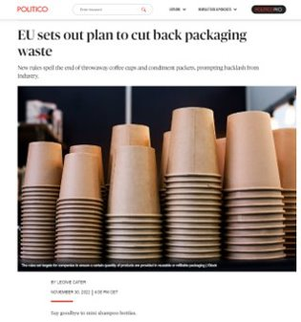
Cirkularní ekonomika – investice do budoucnosti

Slide 2
Circular Economy Action Plan implementation 2022
SPRING PACKAGE
(30 March)
Proposal for a Regulation on Ecodesign for Sustainable Products
EU Strategy for Sustainable and Circular Textiles
Updated EU consumer rules to empower consumers for the green transition
Revision of Construction Products Regulation
AUTUMN PACKAGE
(30 November)
Revision of the Packaging and Packaging Waste Directive
Policy framework on bio-based, biodegradable and compostable plastics
Proposal for a Regulation on an EU certification for carbon removals

Slide 3
Revision of the Packaging and Packaging Waste Directive - Need for action
177 kg of packaging waste per person, or 79.3 million tonnes in total, was generated in the EU27 in 2020
Packaging waste increased by more than 20% over the last 10 years in the EU, and will increase by another 19% until 2030, if no action is taken. For plastic packaging waste, the expected increase is 46% by 2030
Around 40% of plastics and 50% of paper used in the EU is destined for packaging
Reuse of packaging dropped dramatically over the last 10 years
Packaging pollutes soil and land, and is about half of marine littering
Packaging causes C02 emissions equal to the total C02 emissions of a small-medium EU country

Slide 4
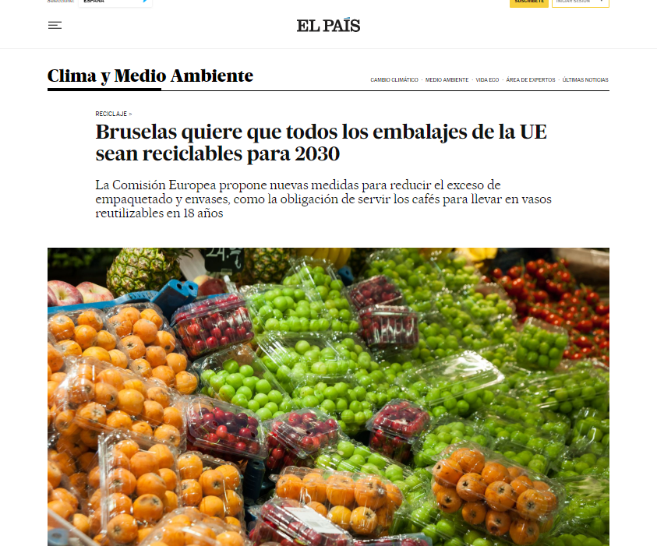

Slide 5
Key measures
1) Targets and measures for packaging waste reduction at MS level (by 15% until 2040 compared to 2018) and mandatory reuse or refill targets in specific sectors e.g. retail, catering
EU-wide standards for over-packaging and a ban on certain forms of unnecessary packaging
2) A definition and assessment procedure to ensure that all packaging placed on the market is ‘recyclable’
3) Mandatory recycled content targets (inclusion rates) for plastic packaging to be per unit of packaging in 2030 and 2040
4) Mandatory compostability for some packaging types
5) Harmonized labelling to facilitate consumer sorting, as well as for reusable packaging, Deposit Return System and recycled content
6) Mandatory deposit return systems for single-use plastic beverage bottles and metal cans
Notes:
The Packaging and Packaging Waste Regulation is a revision of the Packaging and Packaging Waste Directive.
The aims of the Regulation are to prevent and reduce packaging waste, decrease the use of virgin materials and make all packaging recyclable by 2030.
These new rules will act on both the consumer and the industry side, which will put the sector on track for climate neutrality by 2050:
For consumers, the rules will ensure reusable packaging options, get rid of unnecessary packaging, limit overpackaging and provide clear labels to support correct recycling.
For the industry, they will create new business opportunities, especially for smaller companies, decrease the need for virgin materials, boosting Europe’s recycling capacity as well as making Europe less dependent on primary resources and external suppliers.
Some key measures of the proposal include:
Targets for packaging waste reduction in Member States and mandatory reuse or refill targets in sectors such as retail and catering
EU-wide standards for over-packaging
Maximum allowed empty space in e-commerce packaging
Ban on certain forms of unnecessary packaging
Design criteria for all packaging to increase recycling rates
Mandatory compostability for some packaging types, where composting is environmentally beneficial
Mandatory deposit return system for plastic bottle and aluminium cans
Labels on all packaging to facilitate correct waste sorting by consumers and corresponding labels on recycling bins to make it clear where to put each package

Slide 6
Policy framework on bio-based, biodegradable and compostable plastics
Bio-based plastics are the plastics made from biomass, as opposed to conventional plastics, which are made from fossil sources;
Biodegradable plastics are designed to decompose at the end of their life in suitable conditions by the conversion of all their organic constituents;
Compostable plastics are a subset of biodegradable plastics designed to biodegrade under controlled conditions, typically through industrial composting in special facilities for composting or anaerobic digestion.

Slide 7
What’s to come in 2023:
Green claims initiative
Legislative initiative covering voluntary green claims made on products, services and organisations in the EU.
Revision of the Monitoring Framework for the Circular Economy
Update and include new indicators
Legislative proposal on the ‘Right to Repair’
Incentives and tools to consumers to use goods for a longer time, including by repairing defective goods.
Initiative addressing unintentional release of microplastics
Critical Raw Materials Act:
Increase and diversify critical raw materials supply, strengthen circularity, foster resilience and support research and innovation.
Notes:
Monitoring framework for circular economy:
First framework from 2018
The first monitoring framework has a set of ten indicators grouped into four stages and aspects of the circular economy: (1) production and consumption, (2) waste management, (3) secondary raw materials and (4) competitiveness and innovation. This broadly follows the logic and structure of the circular economy action plan.
In the revision, indicators will be updated.

Slide 8
Stakeholder engagement
Advancing the circular economy concept on the ground
Strengthening cooperation among stakeholders' networks
representatives of networks of businesses, civil society and
local, regional and national public authorities
Submit your own good practices, knowledge, strategies and voluntary commitments!
Link to website: http://circulareconomy.europa.eu/platform/
Notes:
In parallel with policy development, we are also working to strengthen cooperation and information sharing among different stakeholders and across value-chains. Diversity is the best recipe for innovation and progress, and creating the conditions for a multitude of ideas to thrive is the key to success.
In cooperation with the European Economic and Social Committee, the European Commission manages the European Circular Economy Stakeholder Platform.
This is a virtual open space which aims at promoting Europe's transition to a circular economy by facilitating policy dialogue among stakeholders and by disseminating activities, information, good practices, and strategies on the circular economy. Stakeholders started sharing their expertise and made them available for replication.
I encourage you to do the same and become a recognized actor in the circular transition.

Slide 9
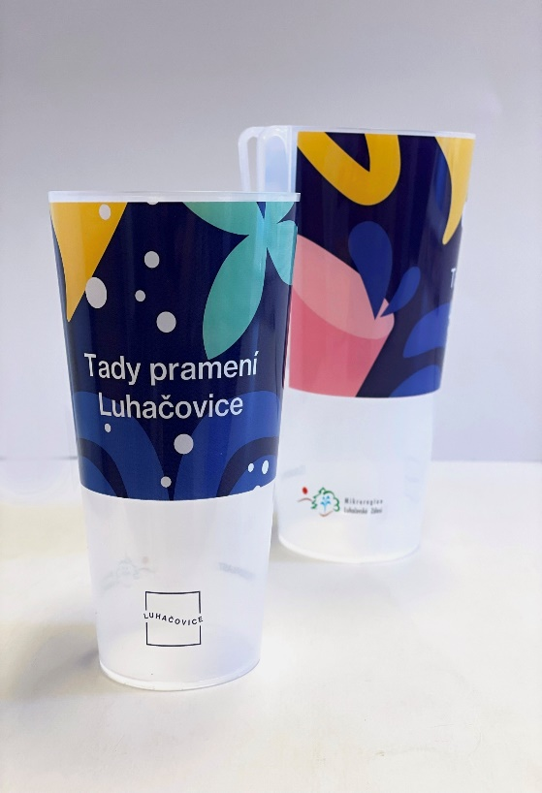
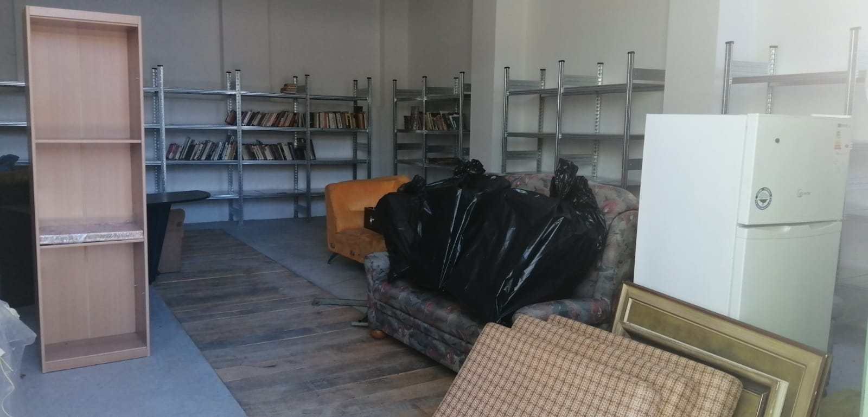
Předcházení vzniku odpadů na území Zlínského kraje
(OP Životní prostředí 2014-2020)

Slide 10
Learn more & Keep in touch
Circular economy action plan (europa.eu)
@EU_ENV
@EUEnvironment
EU Environment and Climate
ourplanet_eu
josef.schwarz@ec.europa.eu
Notes:
Delete/update as appropriate

